Slide 1



Safe Biotechnology for Sustainable wealth Creation: Nigeria as a case study
BY
DR. RUFUS EBEGBA,
CEO,
RUFUS EBEGBA CENTRE FOR LEADERSHIP
AND ENVIRONMENTAL SUSTAINABILITY,
rebegba@gmail.com
24th August 2026

Slide 2

Introduction
Globally, safe science and technology have been known to be drivers of economic development.
New technologies often offer great potentials. But, they also need to be adequately regulated in order to ensure that they are safe to man, as well as being environmentally and socially sustainable.
Modern biotechnology is a fast revolutionary tool in agricultural practice through which many crops are genetically engineered to express traits such as herbicide tolerance, insect resistance, drought tolerance, increased nutritional value and improve animals and microbes.
It also being deployed in the health sector to address medical challenges
Safe Biotechnology creates wealth when it turns biological resources into higher productivity

Slide 3
Introduction contn’d
. Biosafety has become a means of addressing safety in the application of modern technology
Nigeria has Biosafety Framework that consists of Biosafety Policy, Act, regulations and guidelines under a Biosafety Authority(NBMA).
Safe Biotechnology can create sustainable wealth when it turns biological resources into higher productivity,

Slide 4
Wealth and Wealth creation
Wealth : It is the total value of resources and assets that a person, Community or country owns and can be used to meet needs and create more value, ie money , skills, education, ideas
Its total assets you have built over time that can create more value
Wealth Creation: It’s the process of building assets and resources that increase the total value available to a person, community of country.
It turning resources into, skills and time into something that can meet needs now and produce more value later,
Wealth is created by combining 4 things: Resources, Human Capacity, Ideas/Innovation and organization
Wealth is created when value is added to resources.

Slide 5
Application of safe Biotechnology for Sustainable Wealth Creation
Using living organisms, cells and biological systems to produce goods and services that grow the economy without destroying human health or the environment
“Safe” means its regulated , risk assessed and done with proper oversight from relevant authority
Safe Biotechnology : Safe Biotechnology creates wealth when it turns biological resources into higher productivity , better health and cleaner environment sustainability.
Factors that contribute to safe biotechnology are: Policy, law, Competent personnel, Regulatory authority, Risk Assessment, monitoring and Evaluation, funding, safety compliance

Slide 6
Factors that can enhance safe sustainable biotechnology for wealth creation
  Conditions and actions that help wealth grow and last across economic, social envronmental and governance dementions.
  They are the pillars that keep wealth from collapsing from generation to generation
  Good governance and policy,
  Human Capital Development
  Natural Resources Management
  Innovation, biotechnology, Financial inclusion and investment,
  Infrastructure and Institutions
  Social Capacity and Inclusivity

Slide 7
Factors that can enhance safe sustainable biotechnology for wealth creation
  Existence of Biosafety Framework that has both legal and administrative component,
  Safety in the application of modern biotechnology,
  Protective System – with clear goal
  Implementable Law – with clear procedures
  Informed – based on scientific evidence
  Enabling – to allow access to technology
  Enforceable law – for accountability
  Defined authority and not multiple authority
  Capacity,
  Enforcement/ Regulatory Personnel with capacity/expertise

Slide 8
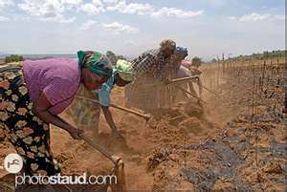
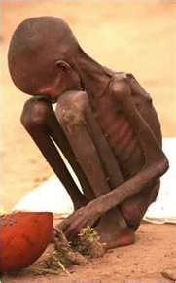
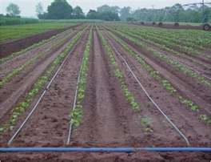
Importance of safe Biotechnology for sustainable wealth creation
FOOD SECURITY
“Food security exists when all people, at all times have physical and economic access to sufficient safe and nutritious food to meet their dietary needs and food preference for an active and healthy life.”
Definition adopted at the world food summit in
1996

Slide 9
Importance of safe Biotechnology for sustainable wealth creation
Modern Biotechnology offers great potential benefits -because Its a solution technology in medicine, food security, industrial advancement, green economy, bio-economy and empowerment,
Existence of Research Institutes
Its products are not derived from chemicals , they are natural with the same content or phenotypically substantially equivalent to their conventional counterparts,
Regulated to ensure safety as their conventional counterparts, (WHO FAO various academy of science, other notable authorities scientifically confirmed this).
Its cost effective,
It is precise in offering breeding solution,
It is complementary to other breeding techniques

Slide 10
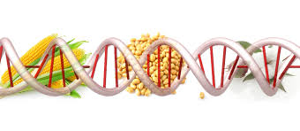
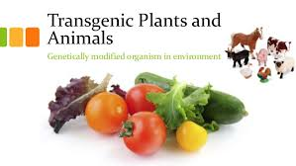
Modern biotechnology
Modern biotechnology is defined according to the Cartagena Protocol on Biosafety to mean the application of in-vitro nucleic acid techniques, or fusion of cells beyond the taxonomic family, that overcomes natural physiological reproductive or recombination barriers.
GMO stands for Genetically Modified Organism, and is a product of modern biotechnology, it describes an organism whose genetic material has been altered through the process of modern biotechnology (genetic engineering techniques) by moving material of inheritance from another organism to another which cannot happen under natural l reproductive condition.

Slide 11
Biotechnology Application
Agriculture
Industry
Medicine/Health
Environment

Slide 12
Biosafety
Biosafety means measures and procedures to ensure adequate level of protection in the transfer, handling and use of living modified organisms resulting from modern biotechnology that may have adverse effects on the conservation and sustainable use of biological diversity, taking also into account risks to human health,
It also takes into account medical health care, epidemiology, agriculture, rDNA experiments, biosecurity and the Biological Weapon Convention (BWC) issues
Concerns:
Environmental safety concerns
Food /Health safety concerns
Socio-economic concerns

Slide 13
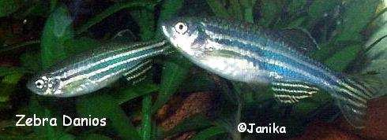
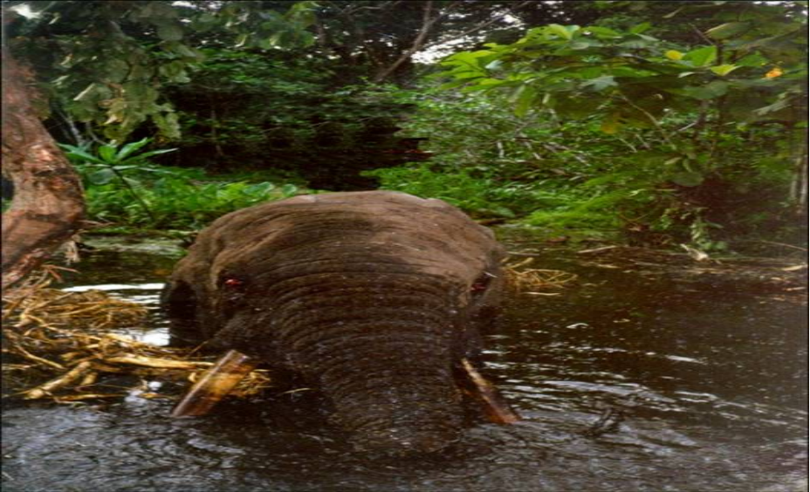
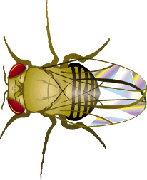
Why Regulating modern Biotechnology
The movement of materials(genes) of inheritance from another organism to another which cannot happen under natural reproductive condition is powerful enough to cause apprehension,
Concerns:
Environmental safety concerns(i.e biodiversity conservation, soil, invasiness, super weeds)
Nigeria as a country is endowed with variety of plant and animal species, which consist of about 7,895 plant species identified in 338 families and 2,215 genera, 22,000 vertebrates and invertebrates species.
Food /Health safety concerns(i.e allergy, toxicity),
Socio-economic concerns
Bio threat and the Biological Weapon,

Slide 14

Nigeria’s International Biosafety Regulatory involvement
Nigeria joined the global community, that took precautionary safety measures by signing (2000) and ratifying (2003) Cartagena Protocol on Biosafety
Nigeria has equally been active in the UN Biosafety Clearing House (BCH) as a means of information exchange on Biosafety issues.
Nigeria Participates in COP-MOP to the Cartagena Protocol on Biosafety Conferences
Nigeria has equally signed and ratified the Nagoya Kuala Lumpur Supplementary protocol on Liability and Redress to the Cartagena Protocol on Biosafety in 2012.
In the region of West Africa Nigeria, is one of those countries yearning for common ECOWAS Biosafety Regulation which is being developed.
In the African Continent, Nigeria has also participated in biosafety initiatives and programs that promote continental biosafety

Slide 15
Factors that Ensure safe Biotechnology for sustainable wealth creation in Nigeria
National Biosafety Policy in place
Biosafety Act in place,
Agency (NBMA) in Place with capacity to enforce biosafety ,
Well trained staff as Biosafety experts
Relevant Biosafety forms in place
Biosafety Regulations in place,
Biosafety Guidelines in Place,
Public awareness and participation encouraged
GMO detection lab in place,
MoU with line MDAs
Successful review of biosafety applications,
Capacity to address Biosafety Risk Assessment and Risk Management,
Nigeria is a model for other African countries on issues of Biosafety
Nigeria is active in global Biosafety

Slide 16
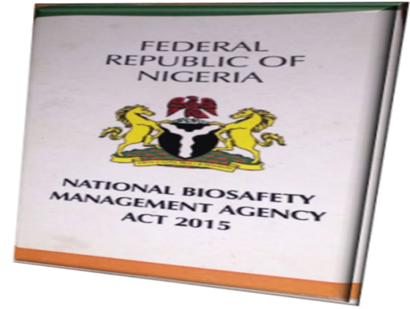
Factors that Ensure safe Biotechnology for sustainable wealth creation in Nigeria
Towards entrenching Legal Biosafety framework in Nigeria :
National Biosafety Management Act 2015 as amended

Slide 17
National Biosafety
Management Act 2015 as amended
Sect. 22 of the Act 2015 specifies that “no person, institution or body shall import, export, transit or deal on GMOs without the prior approval of the NBMA”
Conditions for Biosafety Authorisation in Nigeria
Formal application;
Risk assessment and risk management plan;
Socio-economic consideration.
Provision for labelling for consumers’ choice

Slide 18
National Biosafety
Management Act 2015 as amended cont’nd
The Agency’s mandate as stated in the NBMA Act 2015 is to “provide a regulatory framework, institutional and administrative mechanism for safety measures in the application of modern biotechnology and the use and handling of GMOs in Nigeria”..
The amendment to the Act mandated the Agency to put biosecurity measures in place to contain harmful biological substances/agents from being used to cause harm to human health and the environment.
The amendment also made provisions for emerging aspects of modern biotechnology which are synthetic biology, gene drive and gene editing

Slide 19


National Biosafety Management Agency
(NBMA)
‘THE WHATCH DOG’
The Agency’s mandate as stated in the NBMA Act 2015,
“provides a regulatory framework, institutional and administrative mechanism for safety measures in the application of modern biotechnology and the use and handling of GMOs in Nigeria’’
It Safeguards human health, biodiversity and the environment from any potential, adverse effect of genetically modified organism including food safety.
It has powers to order arrest and prosecute.

Slide 20
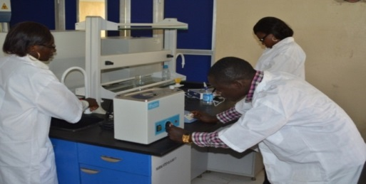
GMOs Detection and Analysis Lab

Slide 21
Biosafety Regulatory Instruments in Nigeria
      National Biosafety Policy;
      Biosafety Act,
      National Biosecurity Policy and Action Plan
      Biosafety application form;
      GMOs import/shipment form
      Accreditation of Institute application form;
      Certification of Biosafety Containment Facility form
.Biosafety Guidelines:
  Confined Field Trial Monitoring and Inspection Manual,
  Biosafety Containment Facilities Guidelines
NBMA’S REGULATORY INSTRUMENTS
BIOSAFETY ACT
BIOSAFETY GUIDELINES
NBC AND NBTC
NATIONAL BIOSAFETY MANUALS AND FORMS
NATIONAL GM, DETECTION AND ANALYSIS LAB
BIOSAFETY POLICY

Slide 22
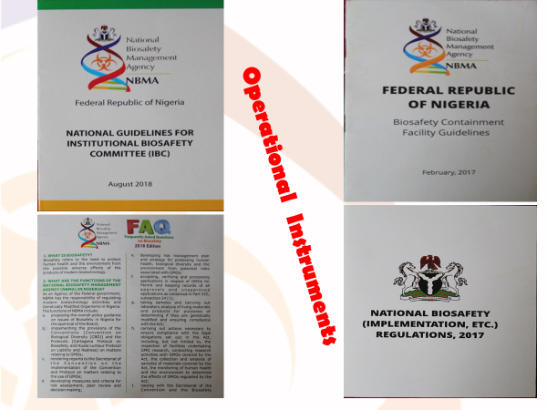
Biosafety Regulatory Instruments in Nigeria Cont’d
  Biosafety Guidelines:
  Nigeria Biosafety Application Administration Guidelines,
  National Biosafety Application Processing Manual.
  National Biosafety Risk Analysis Framework,
  Biosafety Decision document format.
  National Biosafety Management Information Guide,
  National Biosafety Communication strategy
  National Biosafety Emergency Response strategy

Slide 23
Biosafety Regulatory Instruments in Nigeria Cont’d
  Cessation Order ,
  Revocation Order,
  National Biosafety Guidelines on Gene Editing
  National Biosafety Guidelines on GM Grains Inport
  National Biosafety Guidelines on Food and Feed Safety
  National Biosafety Guidelines on Importation of GMO for FFP
  Guidelines on GM Fish
  Guidelines on Low level presence,
  Guidelines on GM Animals
Biosafety regulations:
GMOs import, Export and transit,
GMOs Packaging, identification and transport,,
GMOs Commercial release,
Biosafety Liability and Redress,
GMOs Contained Use and Confined Field trial

Slide 24
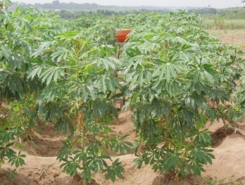
Types of Biosafety Permits granted in Nigeria
Accreditation of institution and certification of containment facilities
Permit for confined field trial i.e cassava, soybean, rice, sorghum
Permit for general/Commercial release i.e Cotton, cowpea, Maize
Permit for import/export i.e maize grain,
Permit for processed food/feed i.e maize, soybean
Permits for dealing with GMOs
Registration of GMO events.

Slide 25
Ensuring safety of modern biotechnology deployment through Nigeria Biosafety Regulatory system
National Budgetary provision for NBMA,
Successful review of Biosafety applications,
Accreditation of Research Institutes and the certification of their Containment facilities,
Institution of annual biosafety conference
National Biosecurity Policy and Action in place,
Compliance with global biosafety.
MoU with sister Agencies
Public participation in Biosafety application review process

Slide 26
Nigeria Biosafety Legacies
Nigeria is benefiting from safe modern biotechnology under a legal framework for economic growth, improved agriculture, job and wealth creation, industrial growth and sustainable environment as operators now have confidence in the sector;
Risks to human health from modern biotechnology practice and the use of genetically modified organisms (GMOs) are avoided;
Dumping of unauthorised GMOs into Nigeria is not possible,
Avenue is being provided to confirm and harness the potentials of modern Biotechnology;
Negative Socio-economic consequences of GMOs are being guarded against
Integrated Biosafety system in place

Slide 27
Conclusion
Safe BioteModern biotechnology practice is one of the most regulated sectors in the worldchnology is essential in attaining sustainable wealth creation considering the great potential of biotechnology ,
To ensure that modern biotechnology application does not cause harm to human health and the environment while harnessing its potentials, holistic biosafety system has been put in place in Nigeria
Nationals should develop sound regulatory framework that can enhance safe application of biotechnology towards sustainable wealth creation.
Value chain associated with biotechnology products is sure way of self economic sustainability of nations.
Nigeria scientists should take advantage of the presence of sound National biosafety framework to solve problems associated with our agricultural sector
Nigeria Biosafety Regulatory Landscape has gone through evolutionary process

Slide 28
Conclusion
Safe Biotechnology is crucial to our national sustainable development and biodiversity conservation
Safety is crucial to the adoption of biotechnology and the deployment of its products safely for our national biodiversity conservation and economic growth.
Political will is required in application of safe biotechnology in the achievement of sustainable wealth creation
we should look at the environment as an economic opportunity and a gift From God which must be stustained.

Slide 29


